Slide 1
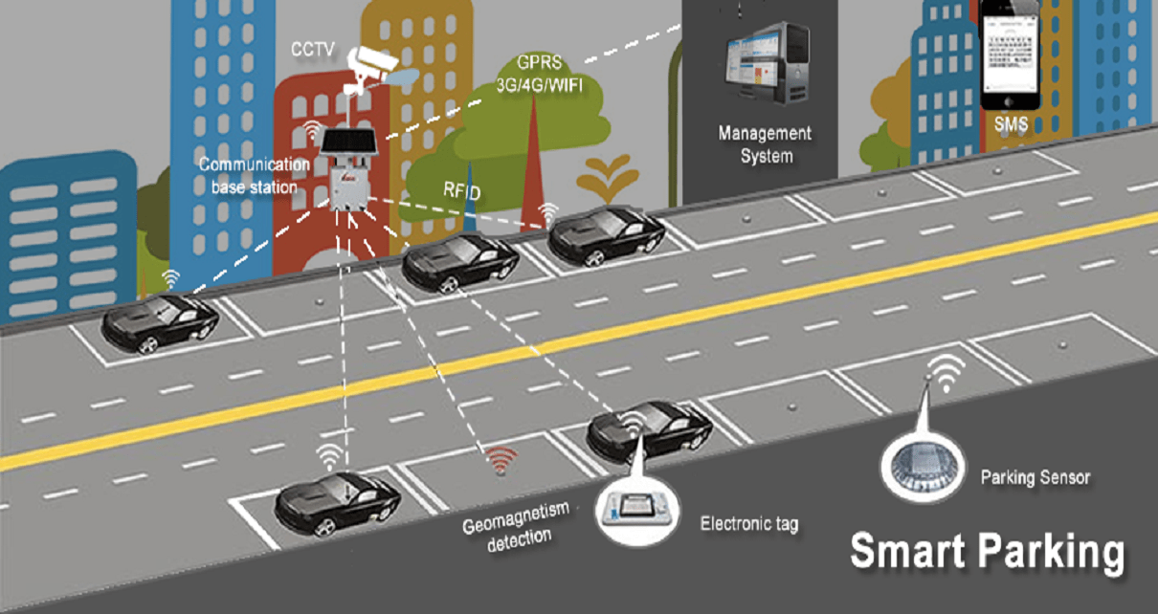
Problem Description:
The city of Round about has a downtown parking problem. Motorists find it hard to find parking even though there are many metered parking street spots in and around the downtown area.
The problem is worse during the peak demand hours of weekday mornings and weekend evenings.
The free parking spots are not always easy to locate.
This leads to a number of motorists roaming around looking for parking which makes the problem worse by creating additional traffic congestion.

Slide 2
Solution addresses following areas:
Hardware/Sensor technology to identify if a parking spot is occupied.
Microcontrollers
Ultrasonic/IR Distance Sensors ( SparkPlug compliant devices )
Camera for Car object/Vehicle Number Plate detection
RFID Scanner for parking booking
Connectivity technology to transmit current state of the parking spot.
LPWAN
A scalable data processing architecture in AWS to maintain parking data.
IoT Core, Rule Engine, AWS Lambda
Parking data is made available to 3rd party app developers to build interesting parking applications.
RDS, DynamoDB, AWS Lambda, IoT Events, API Gateway, Websockets
Platform security & data protection.
MQTT, SSL, X.509, IAM Roles, Cognito/JWT OAuth

Slide 3
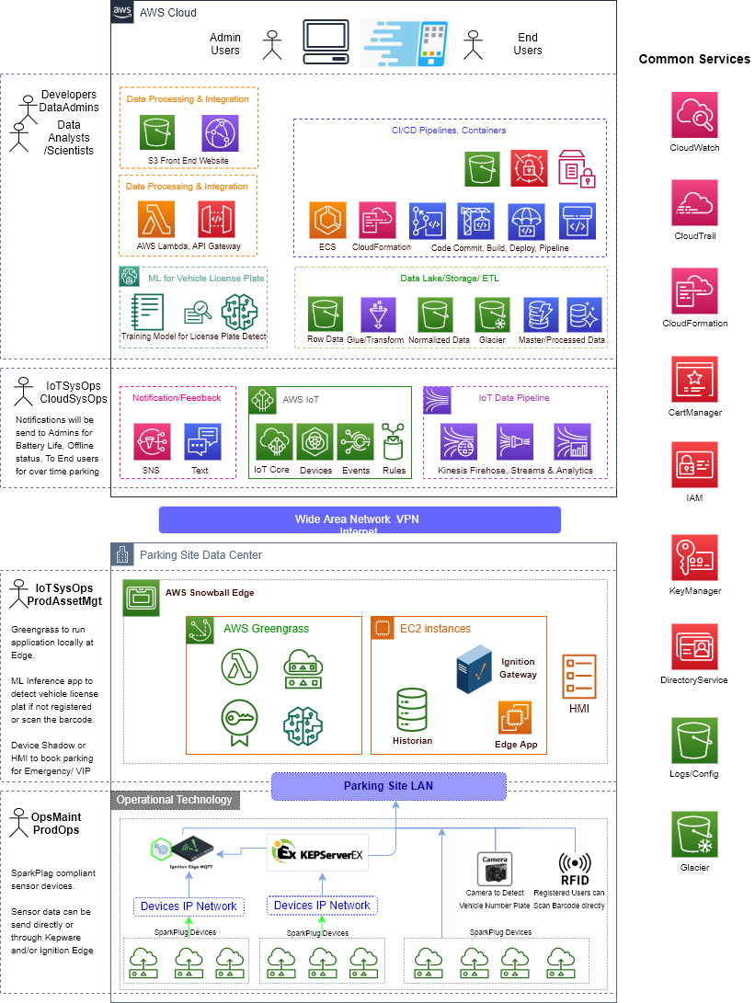

Slide 4
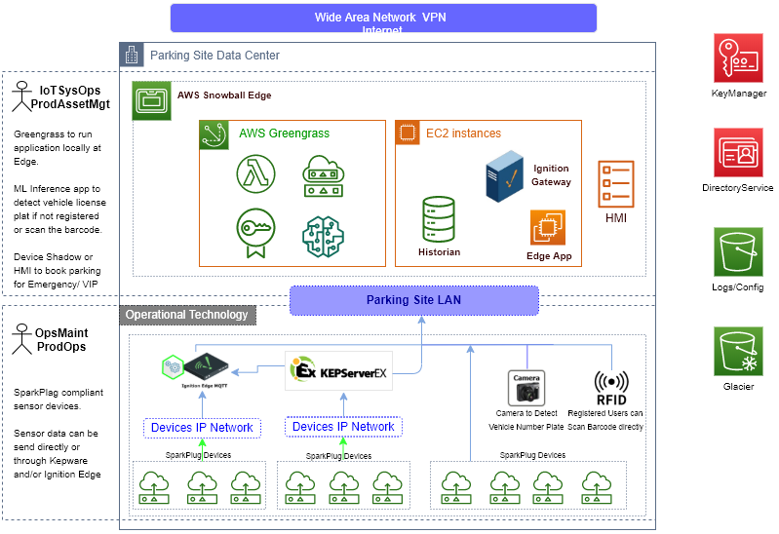
AWS IoT Advance Architecture

Slide 5
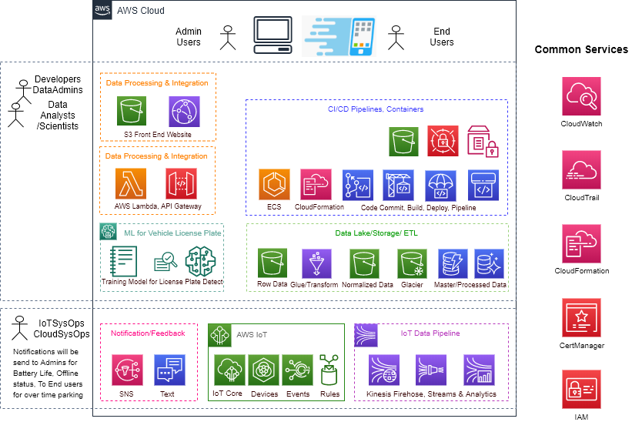
AWS IoT Advance Architecture

Slide 6
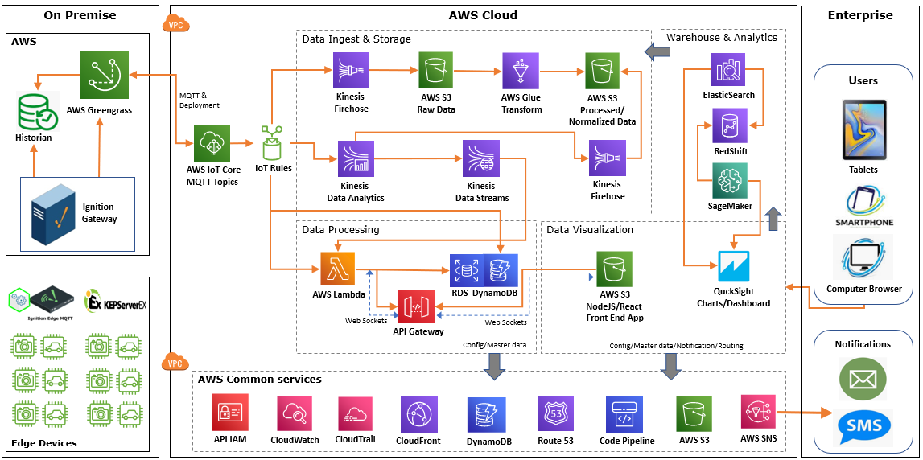
AWS IoT Advance Architecture

Slide 7
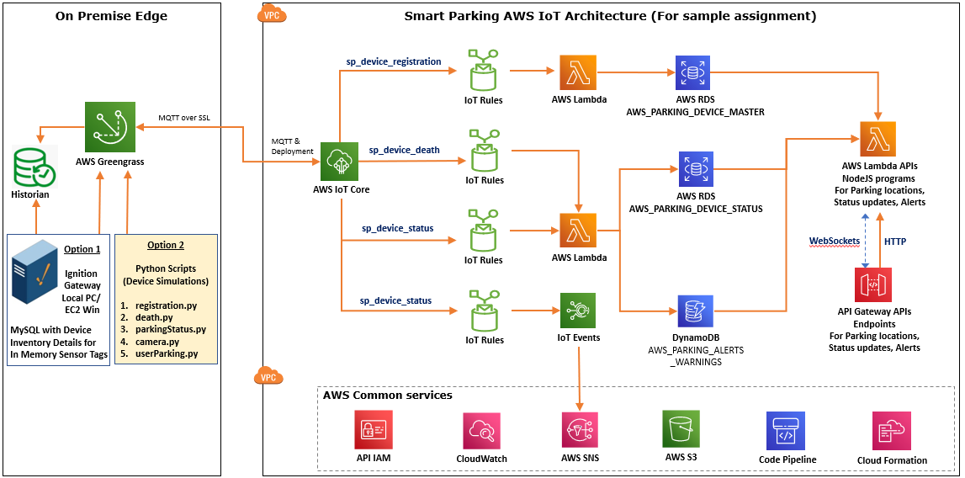
AWS IoT Sample Architecture

Slide 8
Smart Parking Edge Development/Device Provisioning:
After Parking location/site will be decided, work order will be created to order the required hardware.
On hardware arrival Device Inventory details along with parking address & location will be logged into system.
This device inventory information will be used for provisioning devices in AWS Cloud.
There are various ways we can provision the devices.
Create AWS Thing for each of the SparkPlug enabled devices
Create a single thing for Ignition Gateway or ThingWorx ServerEX IoT Gateway
All sensor devices will be registered to this gateway at Edge to send sensor data.

Slide 9
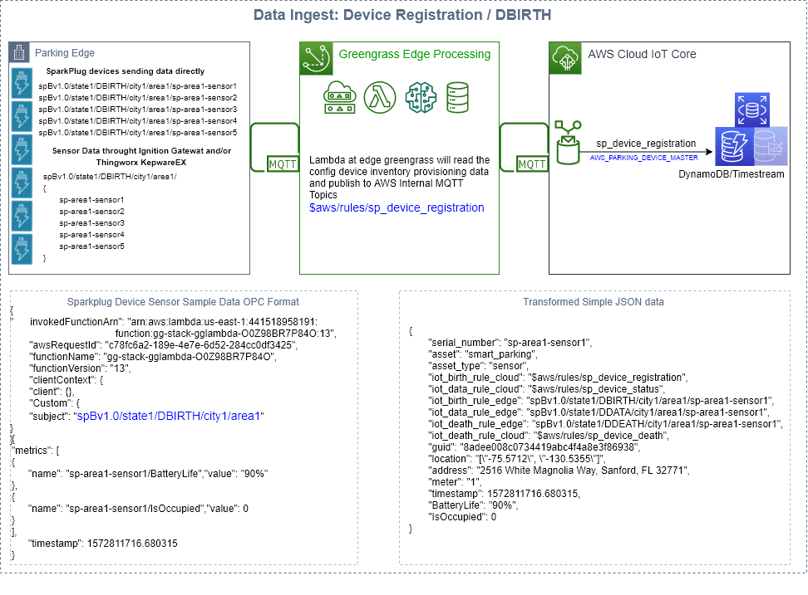

Slide 10
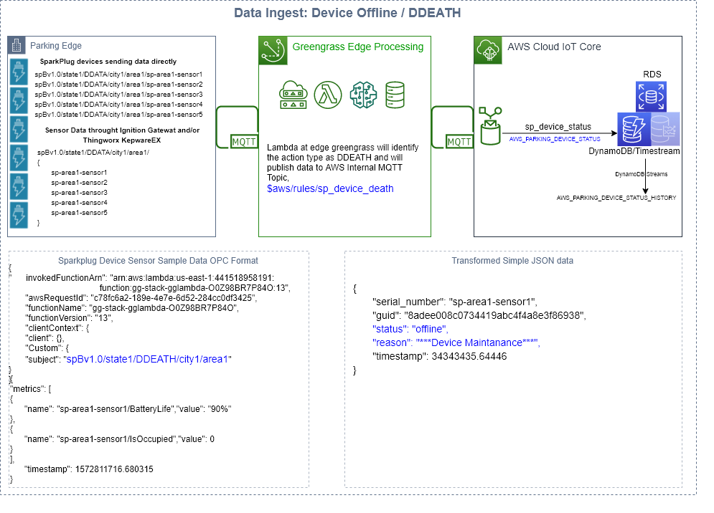

Slide 11
Few Scenarios of sending Device Status Update Data:
Sending sensor device battery life status at regular frequency.
Sensor Data: BatteryLife, serial_number (device unique id)
Greengrass code can be updated to control data send to AWS Cloud. ( Status threshold lower limit = 40, upper = 90 )
Sending parking occupancy status (IsOccupied) on event change.
Sensor Data: IsOccupied, serial_number
Sending user action on parking. Registered user will scan and provide parking hours.
Sensor Data: user_code, parking_hours, serial_number
Edge Camera Inference will be used to detect object to double check parking is available. ( every 15 minutes )
( Helpful if device sensor not working due to some reason)
Sensor Data: IsOccupied, serial_number
Edge Camera Inference will be used to detect Car/Vehicle License Plate Number if user did not check-in parking.
Sensor Data: user_code (license plate number), parking_hours (default 1 hour), serial_number

Slide 12
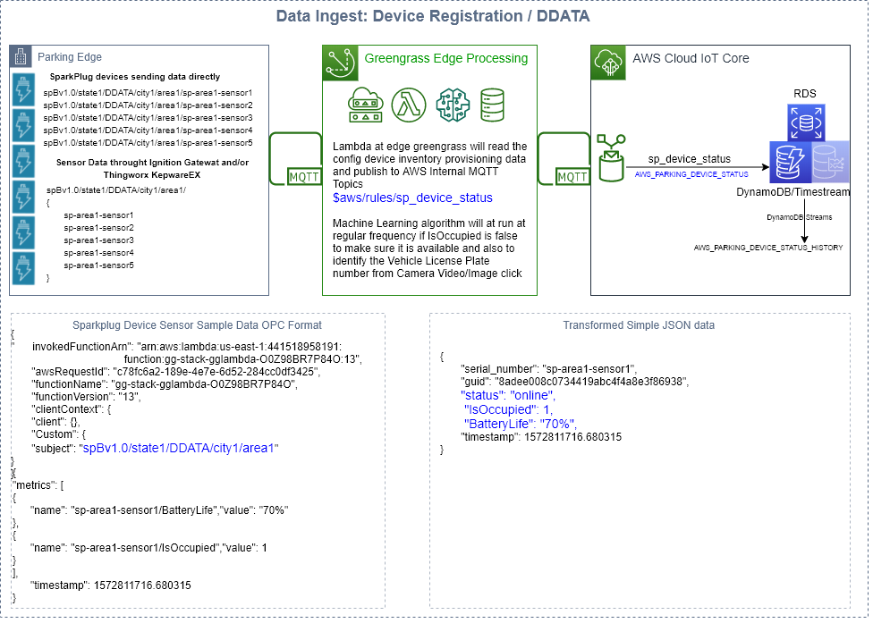

Slide 13
RDS Database Tables:
AWS_PARKING_DEVICE_MASTER
AWS_PARKING_DEVICE_STATUS
AWS_PARKING_DEVICE_STATUS_HIST
AWS_PARKING_USERS
DynamoDB Database Tables:
AWS_PARKING_ALARMS_WARNINGS

Slide 14
AWS IoT Events can be used to log various Parking/Device Events:
Parking Device Distance Sensor Low Battery Power/Life
Past Parking Hours
Parking Edge/Device Maintenances
Parking without user scan or registration
Parked Vehicle License Plate Number not identified
Parked Vehicle License Plate Number mismatch with user registration
Parking Device Camera not working
Parking Device Distance Sensor not working
Note: Have implemented first event only as a part of this IoT sample assignment.

Slide 15
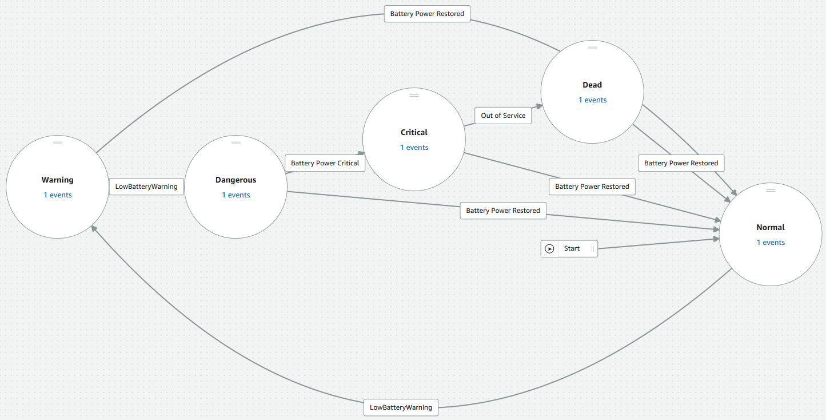
AWS IoT Events Device Battery Status Detector Model

Slide 16
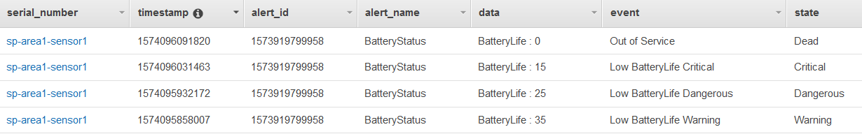
AWS_PARKING_ALERTS_WARNINGS (Testing Data)

Slide 17
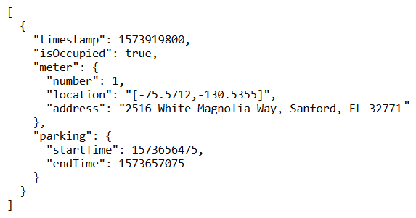
API Gateway & Lambda:
1. Get all parking locations with status.
https://j9juczp0dh.execute-api.us-east-1.amazonaws.com/Test/parking
Method: GET
Parameters: state (code) (mandatory), city, zipcode, address
Sample Response:

Slide 18
API Gateway & Lambda:
2. Get all parking locations which are Available.
https://j9juczp0dh.execute-api.us-east-1.amazonaws.com/Test/parking/available/1
Method: GET
Parameters: state (code) (mandatory), city, zipcode, address
<Currently working on, In Progress>
3. Get all parking locations which are NOT Available.
https://j9juczp0dh.execute-api.us-east-1.amazonaws.com/Test/parking/available/0
Method: GET
Parameters: state (code) (mandatory), city, zipcode, address
<Currently working on, In Progress>
4. Get Parking Edge/Devices Alerts & Warnings.
https://j9juczp0dh.execute-api.us-east-1.amazonaws.com/Test/parking/alerts
Method: GET
Parameters: state (code) (mandatory), city, zipcode, address
<Currently working on, In Progress>

Slide 19
API Gateway & Lambda:
5. Get all registered users.
https://j9juczp0dh.execute-api.us-east-1.amazonaws.com/Test/parking/users
Method: GET
Parameters: state (code) (mandatory), city, zipcode, address
<Currently working on, In Progress>

Slide 20
AWS CodeCommit used for Code Repositories for Edge & Cloud Lambda implementation & APIs
Greengrass Setup & Lambda code:
https://git-codecommit.us-east-1.amazonaws.com/v1/repos/Greengrass
Admin/Third Party/End User API Lambda code:
https://git-codecommit.us-east-1.amazonaws.com/v1/repos/SmartParkingAPIs
Data Ingest & Processing Lambda code:
https://git-codecommit.us-east-1.amazonaws.com/v1/repos/SmartParkingIoTCore
Documents:
https://git-codecommit.us-east-1.amazonaws.com/v1/repos/SmartParking_Docs
IoT Events Templates & Lambdas:
https://git-codecommit.us-east-1.amazonaws.com/v1/repos/SmartParking_IoT_Events
Device Simulation/Testing scripts:
https://git-codecommit.us-east-1.amazonaws.com/v1/repos/SmartParking_Simulation_Scripts

Slide 21
AWS CodePipeLine can be used for CI/CD.
<Currently working on, In Progress>

Slide 22
AWS CloudFormation:
Used for Infrastructure setup as well as CICD code pipeline automation.
<Currently developed CloudFormation/SAM templates for individual lambdas only.
Need to develop the same for other services such as IoT core, RDS, Greengrass & Creating main
Parent Template which will call all above templates as child stack>

Slide 23
Future Scope:
Need to implement this IoT application based on the proposed Advance Architecture.
Inform user for over time parking via Text/Call. Add support to extend the parking hours via Text/Call.
Call Tow Away company for overtime parking violations to Tow vehicle and inform user for the same.
Detect the nearest parking via user App through GPS.
Voice support to find nearest parking site while driving. User has to go actual location for confirmed parking. (Online booking will not be supported)
Handling Emergency & VIP Parking requests. (Device Shadow or similar technique)
Creating batch programs to calculate dynamic parking rates.
- Users parking vehicle without registration will have more rates as system has to detect the vehicle
license plate number and have to call respective 3rd party services to identify user
- Users providing proper parking hours and following the parking timings should get discounted rates.
Machine Learning Vision IoT Inferencing & Training modules for Vehicle Object detection &
License Plate Number identification.
Support of Blockchain to log user parking events & cryptocurrency payments.

